Slide 1
CIS 286 Java II-Data Structures
Chapter 9
Recursion-Part 2

Slide 2
Recurrence Relations
Suppose you have an infinite list of items
  For example, 2, 4, 8, 16, 32, 64, …
Looking at the list, we can see a pattern
We want a formula that shows this pattern
  It should describe an item based on the item(s) before it
  We also need to note the starting number
The formula is called a recurrence relation

Slide 3
Deriving a Recurrence Relation from a List
The book has the method countDown
public void countDown (int n)
{
System.out.print (n);
if (n > 1)
countDown (n-1);
}

Slide 4
Getting the Time
There is one print statement
  I will ignore this in the analysis
There is one comparison
There may be one call to countDown
  This is recursion!

Slide 5
Timing countDown
  Since we don’t actually know the time it takes to call countdown, let’s call it t(n)
    It might be 3n seconds, for example
  t stands for time
  n stands for the n in countDown (int n)
    The time is based on n

Slide 6
Back to Recurrence Relations
So, we have these formulas
  t(1) = 1
    This means countDown (1) has one basic operation
    That’s the compare
  Otherwise, t(n) = 1 + t(n-1)
    The 1 is for the compare
    The t(n-1) is for the recursion

Slide 7
Solving the Recurrence Relation
Here is the recurrence relation
  t (1) = 1 and t (n) = 1 + t (n-1)
We want a formula based on position, not on the other items in the list

Slide 8
Looking for a Pattern
We start by listing the first few terms
  t(1) = 1
  t(2) = 1 + t(2-1) = 1 + t(1) = 1 + 1 = 2
  t(3) = 1 + t(3-1) = 1 + t(2) = 1 + 2 = 3
We try to guess at a pattern

Slide 9
Finding the Pattern
Here is a list of values
Position | Formula
1 | 1
2 | 2
3 | 3
4 | 4
n | ?

Slide 10
Verifying the Pattern-
Math Induction
It has two parts
  A starting point (Called the base step)
  The inductive step
The idea behind it is this
  We prove that the formula holds when we substitute 1 into the formula
  We then prove, that, if the formula holds when we substitute a number for n, it also holds for n+1

Slide 11
Verifying that t(n) = n
Part 1
The Base Step
  t(1) = 1 (the actual value)
  t(1) = 1 (the value predicted by the formula)
  Since these are the same, the base step is verified

Slide 12
Verifying that t(n) = n
Part 2
For the next part, we assume that t(n) = n
We have to prove that t(n+1) = n+1
Here is that proof
    t(n+1) = 1 + t(n) (by the recurrence relation)
    = 1 + n (by our assumption)
We are done!

Slide 13


Another Example of a Recurrence Relation
A truly sneaky way to evaluate x^{n} is by recursion
  The hardware does something similar to this for division!
If n is an even number, then
If n is an odd number, then

Slide 14

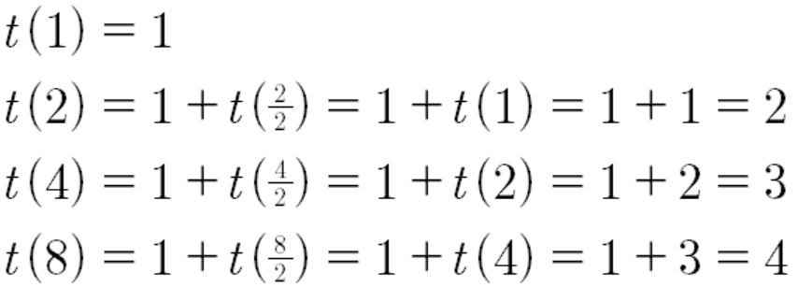
Analyzing This Algorithm
Here for the even exponents
To discover the pattern we try some examples

Slide 15
Finding the Recurrence Relation
If you multiply n by 2, you add 1 to the time
  This is a logarithmic relation
So we find t(n) = 1 + log₂(n)

Slide 16
Verifying the Recurrence Relation Using Induction
Base step
  t(1) = 1 (Actual value)
  t (1) = 1 + log₂(1) = 1 + 0 = 1
Inductive step
  We assume that t(n) = 1 + log₂(n)
  We have to show that t(n+1) = 1 + log₂(n+1)

Slide 17
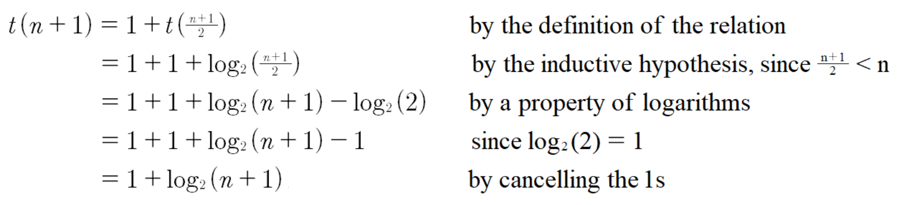
Inductive Step Details
Verification:

Slide 18
Analyzing the
Towers of Hanoi
Suppose m(n) stands for the (total) number of moves required for n disks
So, m(1) = 1, and
m(n) = m(n-1) + 1 + m(n-1)
= 2m(n-1) + 1
As before, we want to find a formula for m(n)

Slide 19
Checking Some Easy Cases to Find the Formula
m(1) = 1
m(2) = 2m(2-1) + 1
= 2 (1) + 1 = 3
m(3) = 2m(2) + 1 = 2(3) + 1 = 7
m(4) = 2m(3) + 1 = 2(7) + 1 = 15

Slide 20
Finding the Formula
It looks like the formula is
  m(n) = 2^{n} – 1
We verify that by induction

Slide 21
Disadvantages of Recursion
The main advantage of recursion is that it simplifies program design
The main disadvantage of recursion is that it is slow
  It’s always slower than iteration
Avoid it if possible
  However, if it’s useful, don’t hesitate to use it

Slide 22
Bad Use of Recursion
Part 1
Both the iterative and the recursive versions of n! are O(n)
But, there is overhead in the recursive calls due to the use of the stack
The recursive version is more costly
It’s easy to code this directly

Slide 23
Bad Use of Recursion
Part 2
The Fibonacci sequence
Let’s check on using the recursive formula for fibonacci (4)
  Here is the formula
    fibonacci (n) = fibonacci (n-1) +fibonacci (n-2)

Slide 24
Getting Help
I need to calculate fibonacci (5)
  I hire two assistants
I tell my first assistant to calculate fibonacci(4)
I tell my second assistant to calculate fibonacci(3)

Slide 25
My Clever Assistants
  My first assistant is supposed to calculate fibonacci(4)
  My first assistant hires two assistants
    The first new assistant will calculate fibonacci(3)
    The second new assistant will calculate fibonacci(2)

Slide 26
My Ever-Alert Second Assistant
  My second assistant is supposed to calculate fibonacci(3)
  My second assistant complains:
    You already have an assistant who is going to calculate fibonacci(3)
    Why don’t you just use that answer?

Slide 27
Iteration As a Replacement for Recursion
The usual way to avoid recursion is to use iteration
  This means using a loop
  It may also require use of an array or a stack or a queue or some other data structure/ADT

Slide 28
Iteration vs. Recursion
Often, it’s easier to code the method using recursion
  Here, “easier” means it simplifies the program design
  One part of readability is how close the code is to the actual object it implements

Slide 29
Extra Ideas about Recursion
A method can use indirect recursion
  This is when A calls B, and B calls A
  This is very tricky
Tail recursion is when the last action in the method is a recursive call
  fibonacci is NOT tail recursive

Slide 30
Tail Recursion
The factorial function is also not tail-recursive, because it has to multiply after the recursive call
To make it tail recursive requires a change

Slide 31
A Tail Recursive Version of the Factorial Function
public static int factorial (int n, int tempFact)
{
if (n==1)
return tempFact;
else
return factorial(n-1, tempFact * n);
}

Slide 32
What’s So Good about Tail Recursion?
In a tail recursive function, you don’t have to push and pop the entire method’s environment
You can, essentially, just use a loop
This is a lot more efficient

